Slide 1
FARMER: Finding Interesting Rule Groups in Microarray Datasets
Notes:
The tentative title of my thesis

Slide 2
Outline
Background
Motivations
Algorithms
Performance Studies
Conclusions
Notes:
Within the framework , we address two technical problems . One is to design algorithms… the other problem is to recycle frequent patterns to speed up subsequent mining. We give two approaches.

Slide 3
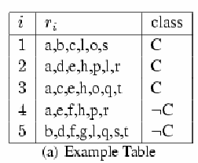

Task
Mining association rules from dataset.
a) Easy to understand
b) Useful for classification
What kind of dataset we deal with..
a) Dataset D consists of a set of rows R={r1,r2..rn}
b) There exists a set of items I={a,b,c,d…}
c) Each row ri consists of a sub set of I,
d) There exists a set of class label C={c1,c2..ck}
e) Each row ri contains a class label from C

Slide 4
Dataset
In the microarray (biology) dataset:
Each row in the dataset corresponds to a sample
Each item value in the dataset corresponds to a distretized gene expression value.
Class labels correspond to category of sample, (cancer / not cancer)

Slide 5
Association Rule
Association rule takes the form of
LHS -> Ci
LHS is a set of items. Ci is a class label.
Support of A: sup(A), the number of rows in dataset containing A.
Support of rule r:LHS->Ci, sup(LHS∪Ci).
Confidence of rule r:LHS->Ci, sup(r)/sup(LHS)

Slide 6
Example
Rule r: {a,e,h} -> C
Support(r)=2
Condifence(r)=66%

Slide 7
General solution
Step1: Find all frequently occurred itemsets from dataset D.
Step2: Generate rule in the form of itemset -> C. Prune rules that do not have enough support an confidence.

Slide 8
Previous Algorithms
Item enumeration: Search all the frequent itemsets by checking all possible combinations of items.
{ }
{a }
{b }
{c }
We can simulate the search process in an item enumeration tree.
{ab }
{ac }
{bc }
{abc }

Slide 9
Previous Algorithms
Rule generation:
e.g., we get frequent itemset {a,e,h}
{a,e,h}->C, sup=2, confidence=66%
{a,e,h}->-C, sup=1, confidence=33%

Slide 10
Microarray data
Features of Microarray data
  A few rows: 100-1000
  A large number of items, 10000
The space of all the combinations of items is large 2¹⁰⁰⁰⁰.

Slide 11
Motivations--Challenges
Very slow for existing rule mining algorithms
  Item search space is exponential to the number of item
  use the idea of row enumeration to design new algorithm
The number of association rules are too huge even for a given consequent
  mine Interesting rule groups
Notes:
We can know what combinations of gene expression will indicate cancer.

Slide 12
Definition
Row support set: Given a set of items I’, we denote R(I’) as the largest set of rows that contain I.
Item support set: Given a set of rows R’, we denote I(R’) as the largest set of items that are common among rows in R’.

Slide 13
Example
I’={a,e,h}, then R(I’)={r2,r3,r4}
R’={r2,r3}, then I(R’)={a,e,h}

Slide 14
FARMER: Rule Group
What is rule group?
Given a one row dataset: {a, b, c, d, e, Cancer}, 31 rules in the form of LHS → Cancer.
    the same row and the same confidence (100%).
    1 upper bound and 5 lower bound
Rule group: a set of association rules whose LHS itemsets occurs in a same set of rows.
Rule group has a unique upper bound.
abcde->Cancer

Slide 15
FARMER: Interesting Rule Group
  Consider two rules:
  abcd → Cancer (confidence 90%)
  ab → Cancer (confidence 95%).
  ab is a better indicator of Cancer than abcd
    ab → Cancer has a higher confidence and
    all rows covering abcd → Cancer must cover ab → Cancer
IRG: Rule Group R is IRG if there exists no other IRG R’ whose upper bound rule r’_{u} is a subset of R’s upper bound r_{u} and confidence(r’_{u})>confidence(r_{u})

Slide 16
IRG
Each IRG corresponds to a unique row set R.
Each IRG has a unique upper bound rule r_{u}.
Given a row set R’, we can get a unique IRG whose upper bound rule is
I(R’) -> C
and whose corresponding row set is
R(I(R’))

Slide 17
Example
Given row set R’={r2,r3}
I(R’)={a,e,h}
IRG:
r_{u}=: {a,e,h}->C
row set= R(I(R’))=R({a,e,h})={r2,r3,r4}
Support(r_{u})=2
Confidence(r_{u})=66%
{a,e}->C, {a,h}->C…

Slide 18
FARMER: Row Enumeration
Search in the space of all combinations of rows. Smaller size 2¹⁰⁰⁰. (<<2¹⁰⁰⁰⁰)
Since
each IRG -> a unique rowset
each rowset -> a unique IRG
We can get all IRG by row enumeration

Slide 19
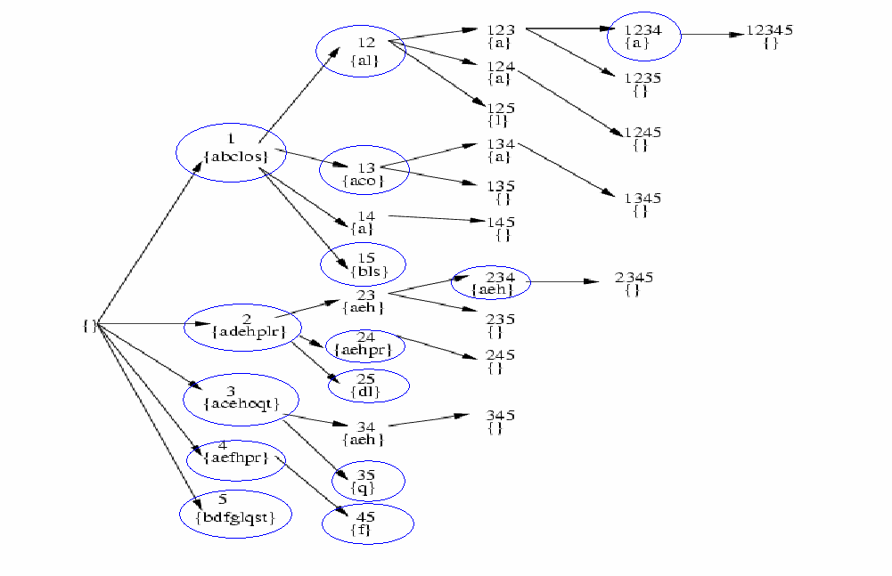
Row Enumeration Tree
Notes:
Complete row enumeration space. Obviously, it is not necessary to do such a complete enumeration. There is no space in

Slide 20
General Pruning method
Estimate upper bound for pruning
  Minimum support
  Minimum confidence
  Minimum chi square

Slide 21
IRG and Association Rules
From IRG, we can get the entire set of association rules found by any other item enumeration rule mining algorithms.
Any association rule found in those algorithm belongs to one of the IRG we found.

Slide 22

IRG and Association Rules
Given an IRG with upper bound r_{u} and lower bound set R_{L}.
Any rule r’ with
belongs to IRG and has same support and confidence.
IRG1: ru=: {a,e,h}->C
RL={{e}->C, {h}->C,}
{a,e}->C, {a,h}->C…belongs to IRG1

Slide 23
Lower Bound
Lower Bound can be generated from upper bound.
Find smallest subset of upper bound that occurs only in the row set of the IRG.
Use incremental generate method

Slide 24
Experimental studies
Efficiency of FARMER
  On five real-life dataset
    Varying the minimum support
    Varying the minimum confidence
    Varying the minimum chi-square
  Benchmark
    CHARM
    ColumnE
Usefulness of IRGs
  Classification

Slide 25
Dataset
Clinical dataset: Prostate Cancer
136 rows, 12600 items
Class1 tumor, class2 normal

Slide 26
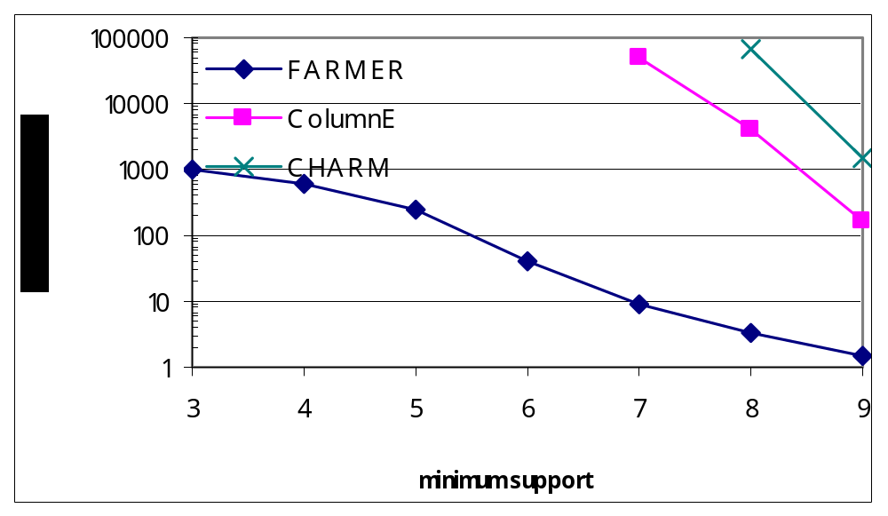
Example results--Prostate

Slide 27
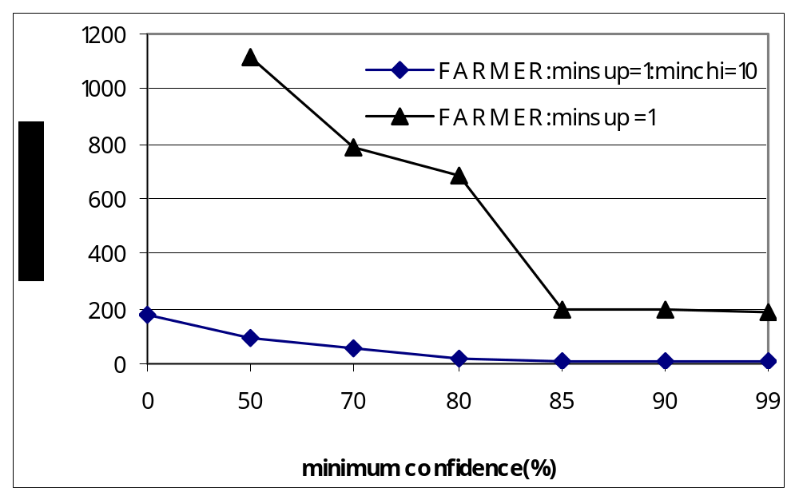
Example results--Prostate

Slide 28
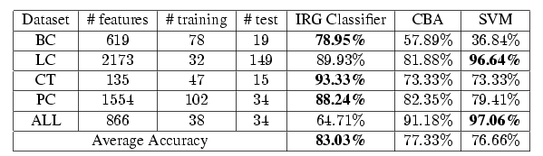
Classification results

Slide 29
Conclusions
Proposed a novel algorithm to discover interesting rule group for given consequent.
Much more efficient than previous item enumeration algorithms when handling microarray dataset.

Slide 30
Thank You

Slide 31
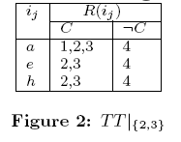
Prune Method 1
Removing items that appear in all tuples of transposed DB will not affect results
r2 r3 {aeh}
r2 r3 r4 {aeh}
r4 has 100% support in the projected table of “r2r3”, therefore branch “r2 r3r4” will be pruned.

Slide 32
Pruning method 2
At a node, if an upper bound rule is detected to be discovered before, we can prune enumeration below this node
  Because all upper bounds below this node has been discovered before
  For example, at node 34, if we found that 2 appear in all tuple of TT|₃₄, we can prune node 34

Slide 33
Pruning method 3--
Minimum Support
Given X= {x₁, x₂, …, x_{n}} and TT|_{X} (x_{n} positive class)
Loose upper bound:
  obtained before scanning transposed table
  |X|+LU, LU--the number of possible extensions of X in TT|_{X}
Tight upper bound:
  obtained after scanning transposed table
  |X|+TU, TU--the maximal number of possible extension in all tuples of TT|_{X}

Slide 34
Pruning method 3-- Minimum Confidence
Given X= {x₁, x₂, …, x_{n}} and TT|_{X} rule r
Conf(r) = a/(a+b)
  a – the occurrences of rule r in positive
  b – the occurrences of rule r in negative
  Is maximized at largest possible a and smallest b
Loose upper bound:
  The maximal possible a before scanning
  b at the node X
Tight upper bound
  The maximal possible a after scanning
  b at the node X

Slide 35
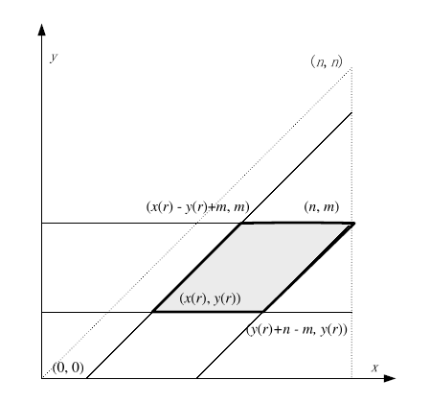
Pruning method 3—
Minimum chi-square

Slide 36
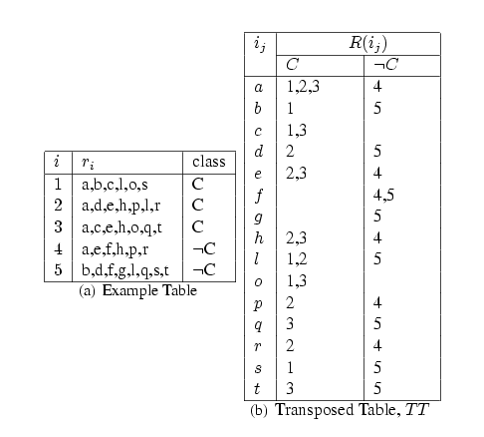
Example
Figure 1: Example Table

Slide 37
Lower Bounds
Algorithm of discovering lower bounds for an upper bound
  Incremental method to update
  Example: An upper bound rule with antecedent A=abcde and two rows (r1 : abcf ) and (r2 : cdeg)
  Initialize lower bounds {a, b, c, d, e}
  add “abc”--- new lower {d ,e}
  Add “cde”--- new lower {ad, bd, ae, be}

